Slide 1


The Student Perspective on Student Success
Megan O’ Connor
Vice President for Academic Affairs, Union of Students Ireland
Notes:
Hello, it’s lovely to meet you all virtually and be with you today. My name is Megan O’ Connor, I am the Vice President for Academic Affairs for the Union of students in Ireland and I am here to talk to you about can we engage students as partners, to enhance teaching and learning in higher education.
It’s a big question, as student engagement can be different for everyone but an incredibly important question and I hope you all leave here today with a little more of an idea as to how you can implement this within your own role in your institution.

Slide 2

About USI
National representative body for third level students in Further & Higher Education, representing over 374,000 students across the Island of Ireland, both in the ROI & NI
Policy development and implementation
Advocacy and Lobbying
Education & awareness campaigns on student wellbeing, exam destress, student engagement & partnership, consent, financial hardship, accommodation (overall college experience)
Notes:
So what is “student engagement”?
We hear a lot about the “student voice” and “students as partners” but what does that mean in practice? In truth, we could define student engagement in any way we want, as it is different for everyone and consequently, can be different to coordinate.
We must have student centred outcomes and ensure that students play an active part, as co-creators in the decision making process.
Meaningful student engagement is not gained from facilitating student representatives on a committee, but through dialogue, inclusivity and empowerment.

Slide 3

About Me
Megan O' Connor
General Nursing Graduate, Trinity College Dublin
Role of the Vice President for Academic Affairs;
  Assessment
  Quality assurance
  International Affairs
  Student Partnership & Engagement.
Notes:
So what is “student engagement”?
We hear a lot about the “student voice” and “students as partners” but what does that mean in practice? In truth, we could define student engagement in any way we want, as it is different for everyone and consequently, can be different to coordinate.
We must have student centred outcomes and ensure that students play an active part, as co-creators in the decision making process.
Meaningful student engagement is not gained from facilitating student representatives on a committee, but through dialogue, inclusivity and empowerment.

Slide 4

Student Success
"Student Success is everyone's business"
Partnership between students and student organisations with the National Forum, the HEA and Higher Education Institutions is invaluable
Student success is a complex concept and perhaps traditional perceptions of student success have been too focused on singular outcomes of success
Success can mean several things and can be achieved in many ways
Personal
Academic
Social

Slide 5
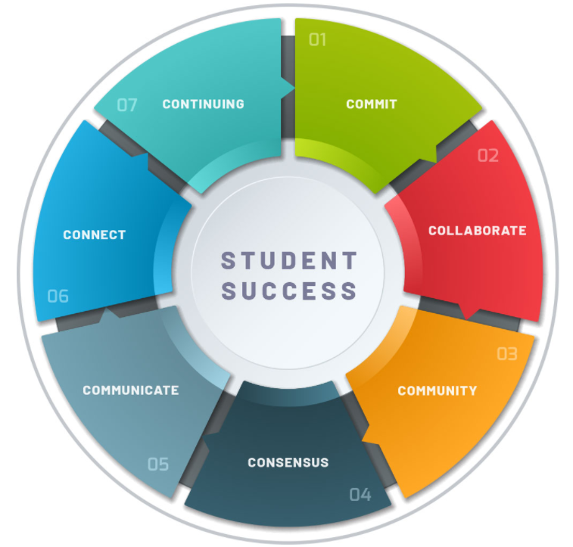
Student Success Toolkit
The National Forum's Seven Cs Toolkit was developed as a resource for higher education institutions.
A systematic process for embedding the continuous enhancement of student success.
Resources for HEI'S to 'take stock' of how student success is currently embedded
Identify what currently works well
What needs to be developed further
Challenges institutions to consider the impact of all potential policies, practices and actions on both staff and students
Encourages conversations, debates and planning of how best to embed student success in a sustainable way across all functional areas of the institution
The Seven C's for Student Success, National Forum for Teaching and Learning (2021)
Notes:
So what is “student engagement”?
We hear a lot about the “student voice” and “students as partners” but what does that mean in practice? In truth, we could define student engagement in any way we want, as it is different for everyone and consequently, can be different to coordinate.
We must have student centred outcomes and ensure that students play an active part, as co-creators in the decision making process.
Meaningful student engagement is not gained from facilitating student representatives on a committee, but through dialogue, inclusivity and empowerment.

Slide 6



USI's National Report on Student Mental Health
In 2019, USI launched the 'National Report on Student Mental Health in Third Level Education’.
Analysed and detailed the results of the first National Student Mental Health Survey
Over 3,300 participants were surveyed
Each year, the USI runs a national mental health campaign which aim to
- Support students in speaking up about their mental health
- Destigmatising conversations about mental wellbeing
- Lobbying for improved mental health supports in Ireland
- Providing practical supports to students

Slide 7

Wellbeing in the Curriculum
Partnership with the National Forum.
How wellbeing is embedded in the curricula of higher education institutions and identify features of good practice.
  Further investigation into best practice
  Professional development for staff
  Whole institution approach
  Senior Management, Academic and Support Staff and Student Partnership
  Evidence informed nationally led, collaboration to identify good practice
  National collaborative network
-

Slide 8

My Person Experience
Student2Student Peer-mentoring
- Guidance
- Practical Support
- Friends
- Social Activities
- Signposting
- Long lasting impact
Notes:
So what is “student engagement”?
We hear a lot about the “student voice” and “students as partners” but what does that mean in practice? In truth, we could define student engagement in any way we want, as it is different for everyone and consequently, can be different to coordinate.
We must have student centred outcomes and ensure that students play an active part, as co-creators in the decision making process.
Meaningful student engagement is not gained from facilitating student representatives on a committee, but through dialogue, inclusivity and empowerment.

Slide 9
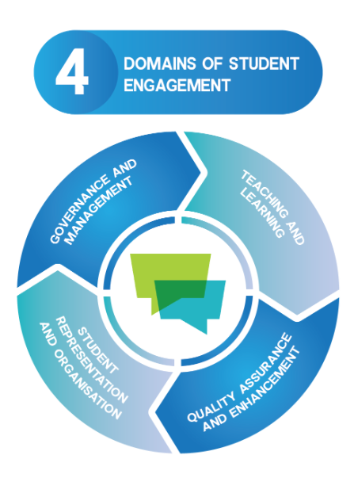
Student Representation
Student representation and organisation includes all activities that are student-led or peer-led
This includes representation structures, which most often take the form of students’ unions and student councils
It also extends to other forms of organisation like peer-support initiatives, clubs and societies, or even less structured organisation like campaign groups
NStEP (2021)
Notes:
So what is “student engagement”?
We hear a lot about the “student voice” and “students as partners” but what does that mean in practice? In truth, we could define student engagement in any way we want, as it is different for everyone and consequently, can be different to coordinate.
We must have student centred outcomes and ensure that students play an active part, as co-creators in the decision making process.
Meaningful student engagement is not gained from facilitating student representatives on a committee, but through dialogue, inclusivity and empowerment.

Slide 10
Student Representation
The way students’ unions are current organised is due to the way in which higher education has become more accessible to a more diverse student population, but also because of inequality and inaccessibility
A greater emphasis on democratic membership organisations, even if they aren’t perceived as radical, has meant a greater emphasis on participative, empowering, and collective senses of what higher education should be
We must ensure that our focus going forward is not just on progression and access or a tick the box exercise in “student engagement” but that we continue these meaningful conversations and facilitation of projects to ensure the betterment of the Student Experience
Notes:
So what is “student engagement”?
We hear a lot about the “student voice” and “students as partners” but what does that mean in practice? In truth, we could define student engagement in any way we want, as it is different for everyone and consequently, can be different to coordinate.
We must have student centred outcomes and ensure that students play an active part, as co-creators in the decision making process.
Meaningful student engagement is not gained from facilitating student representatives on a committee, but through dialogue, inclusivity and empowerment.

Slide 11
What is Student Partnership?
The practice that both drives forward and emerges from meaningful student engagement which recognises the need to re-balance power dynamics in higher education. It seeks to enable a culture of change through collaboration, reciprocity and shared responsibility between staff and students.
National Student Engagement Programme (2020)
Notes:
Partnership denotes an engagement that is shared or equal (Felten, Bovill, and Cook-Sather, 2014), that provides co-ownership, and that creates space to actively work together, but not all students will take up those opportunities and staff may face limitations like workload and time. This requires us to explore why these limitations exist and to reconsider how engagement and partnership can be inclusive.

Slide 12
Student Partnership
Does partnership mean 'equal’ or ‘equal responsibility’?
Hildyard (2001), raises the idea of getting stakeholders around the table but notes the ‘dubious assumption’ that this creates a ‘fair’ partnership - We can’t assume that will create equal relationships
Negotiation or negotiating the way things are done means that each partner in the process must have the ability to bargain, to argue, to challenge
Equal partnership isn’t always about equal roles or responsibilities. It’s about being equally valued, welcomed, and accepted within the partnership and having the ability to contribute and participate in a meaningful manner
Hildyard et al. (2001) pg 61
Notes:
Why is it important
Students are not the consumers of education provided, they are future professions. Future researches, teachers, healthcare workers etc. Students are experts in their own right and they should be co creators of their education
In Ireland, research is valued as the most important aspect of an academics career.
Steps take by the National Forum for Teaching and Learning - VITAL week
https://www.teachingandlearning.ie/vital/
Who are the relevant stakeholders
HEI’s Students, Future students, the public - professionals, funding & accreditation agencies,
University management, parents (pay), the faculty,, alumni,

Slide 13
Student Engagement in Decision Making
To enhance that decision-making, we need to ensure student representation systems are robust
HEI's must engage with their students’ union and student representatives as we can’t assume we share the same definitions or understandings of the role of student representatives
Staff and students need to explore these roles, clarify them, and ensure they aren’t being restricted by institutional norms
From empowerment and collaboration, student representatives will derive a greater legitimacy as part of a partnership culture.
This culture has emerged due to students changing relationships with how we expect to learn and shape our own college experience
Notes:
Why is it important
Students are not the consumers of education provided, they are future professions. Future researches, teachers, healthcare workers etc. Students are experts in their own right and they should be co creators of their education
In Ireland, research is valued as the most important aspect of an academics career.
Steps take by the National Forum for Teaching and Learning - VITAL week
https://www.teachingandlearning.ie/vital/
Who are the relevant stakeholders
HEI’s Students, Future students, the public - professionals, funding & accreditation agencies,
University management, parents (pay), the faculty,, alumni,

Slide 14
Challenges in achieving Student Engagement in Student Success
Not all students will take up opportunities to collaborate
Staff may face limitations like workload and time
Knowing where to start
Implementation and formation of policy
Senior Management buy-in
Sustainability of projects

Slide 15
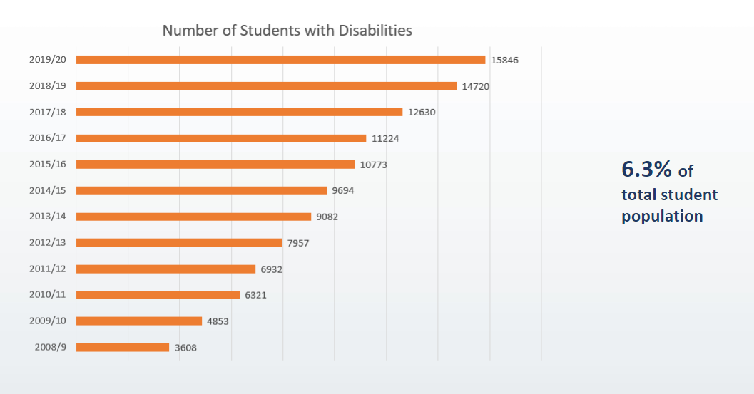
Impact
AHEAD (2021)

Slide 16
Thank you :)
Megan O’ Connor
Vice President for Academic Affairs with the Union of Students Ireland
academicaffairs@usi.ie +353(86) 816 5498

Slide 17
References
AHEAD (2021)
Higher Education Authority’s Enhancing Student Engagement in Decision-Making Report (2016)
Hildyard et al. (2001) pg 61
National Forum for Teaching and Learning: Student Success Toolkit (2021)
National Report on Student Mental Health in Third Level Education (2019)
National Student Engagement Programme (2021)
Wellbeing in the Curriculum (2021)

